Slide 1
Quality Assessment and Communicating Student Learning
Updated October 2022
Part 3
Notes:
Welcome to part 3 of the Quality Assessment and communicating student learning video series.

Slide 2
Included in Part 3
Understanding the Design of BC’s Redesigned Curriculum
KUD Model
Learner Centered
Core Competencies
Concept Based, Competency driven
Growth over time
Notes:
Included in Part 3
Understanding the Design of BC’s Redesigned Curriculum
KUD Model
Learner Centered
Core Competencies
Concept Based, Competency driven
Essential Learning
Growth over tim
Before we begin to unpack the design of BCs Curriculum, we would like to share a short video from the Ministry of Education and Childcare that outlines the key features of the curriculum.

Slide 3
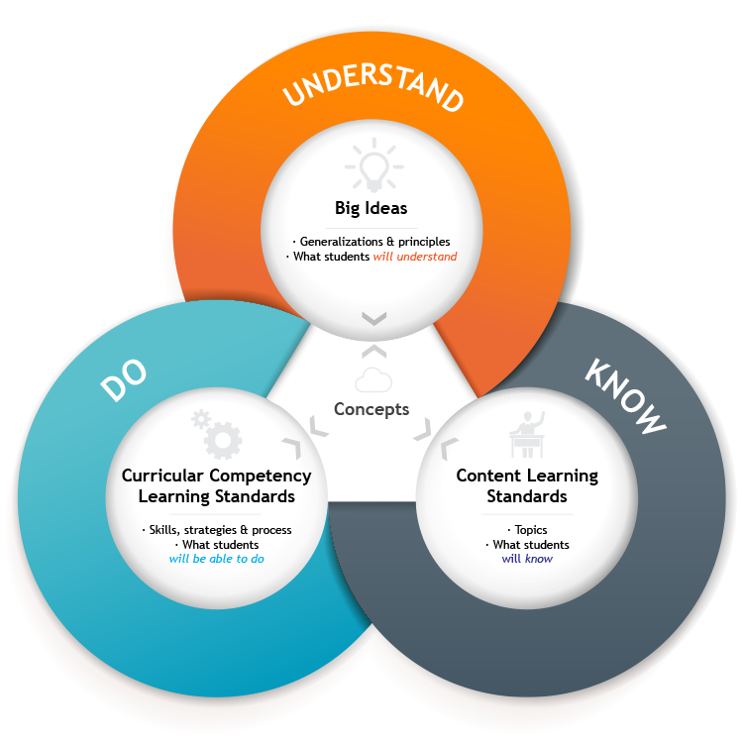
KDU Curriculum Model
All areas of learning are based on a "know-do-understand" model to support a concept-based competency driven approach to learning
Notes:
British Columbia’s redesigned curriculum brings together two features that most educators agree are essential for 21st-century learning: a concept-based approach to learning and a focus on the development of competencies, to foster deeper, more transferable learning. These approaches complement each other because of their common focus on active engagement of students. Deeper learning is better achieved through “doing” than through passive listening or reading. Similarly, both concept-based learning and the development of competencies engage students in authentic tasks that connect learning to the real world.

Slide 4
Deeper Learning Deeper learning refers to learning that emphasizes the use of key disciplinary concepts, principles, and generalizations to think critically, solve problems, and communicate ideas.
develop students’ understanding and promote thinking about and applying their learning in meaningful ways
Help students build an increasingly sophisticated conceptual understanding of how knowledge has been constructed within a particular topic or discipline and different perspectives of knowledge construction
Help students build generalizations and mental models of the world that allow them to make sense of new information and connect it to prior knowledge
Go beyond rote learning or surface learning, where a student may memorize a procedure or formula, but does not actually understand the underlying principle
Go beyond passively receiving content and involves students in actively developing and explaining their knowledge
is not assessed by the ability to recall specific content or explanations
Notes:
We keep hearing the term “deep learning”, and wanted to take a couple of minutes to define it
Deeper learning refers to learning that emphasizes the use of key disciplinary concepts, principles, and generalizations to think critically, solve problems, and communicate ideas.
develops students’ understanding and promotes thinking about and applying their learning in meaningful ways
helps students build an increasingly sophisticated conceptual understanding of how knowledge has been constructed within a particular topic or discipline
helps students build generalizations and mental models of the world that allow them to make sense of new information and connect it to prior knowledge
goes beyond rote learning or surface learning, where a student may memorize a procedure or formula, but does not actually understand the underlying principle
goes beyond passively receiving content and involves students in actively developing and explaining their knowledge
is not assessed by the ability to recall specific content or explanations

Slide 5
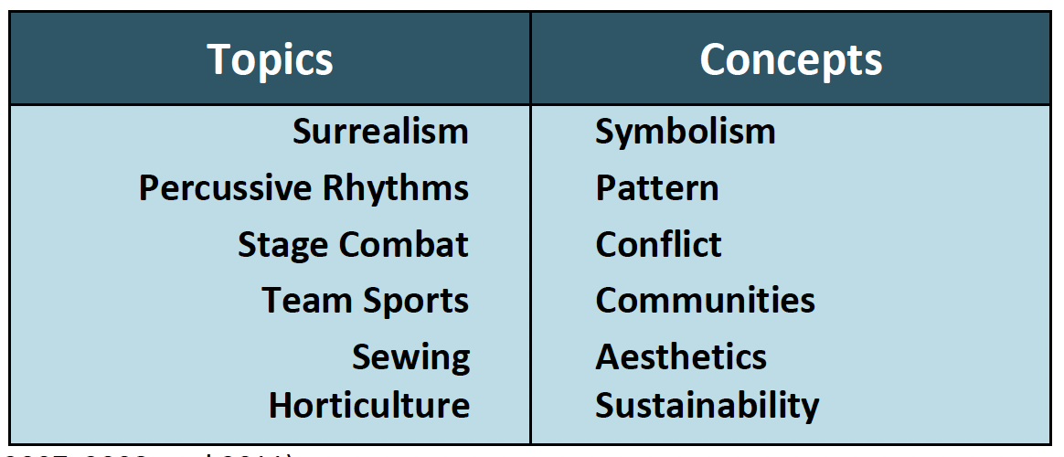
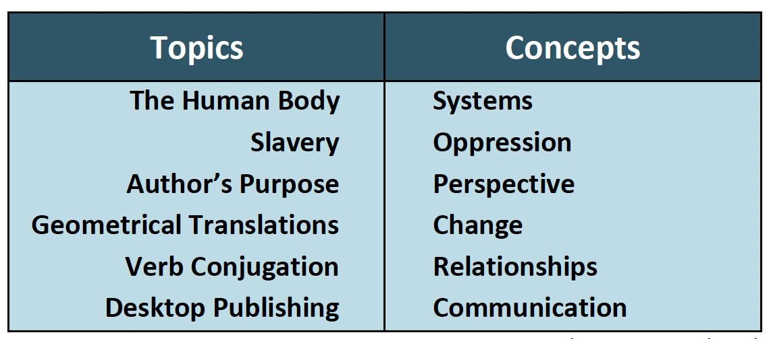
Concept-Based
Concept-based instruction is driven by “big ideas” rather than subject-specific content. By leading students to consider the context in which they will use their understanding, concept-based learning brings “real world” meaning to content knowledge and skills.
An important reminder: concepts are not intended to replace content. Instead, concepts bring context and purpose to the content students are exploring. Is not a list of topics to cover in isolation from one another
concepts are universal, timeless, abstract, and move students toward higher levels of thinking. Concepts are broad ideas that transcend the perspectives and limits of any specific subject-area.
Notes:
So what does concept based, competency driven mean?
A concept-based curriculum uses concepts to define standards of knowledge and skills associated with a given area of learning. It is focused on the key concepts, principles, and generalizations that are used to organize knowledge and solve problems within and across disciplines.
A concept-based curriculum:
is built around higher-order learning standards and big ideas, allowing a more in-depth exploration of topics in order to build deeper understanding
replaces the study of factual information with the development of conceptual understanding and disciplinary skills
offers opportunities for transfer of learning
is not a list of topics to cover in isolation from one another
A concept-based curriculum allows for connections between big ideas, such as exploring the concept of reoccurring patterns, and comparing and contrasting how patterns appear in works of literature or in geographical features.

Slide 6
Competency-Driven
A competency-driven curriculum is a curriculum that emphasizes what learners are expected to do rather than mainly focusing on what they are expected to know
In principle, such a curriculum is learner-centered and adaptive to the changing needs of students, teachers, and society.
Competencies include skills, strategies, processes, applications and dispositions
These can be defined for students in the form of learning progressions/ proficiency scales
Notes:
Record after

Slide 7
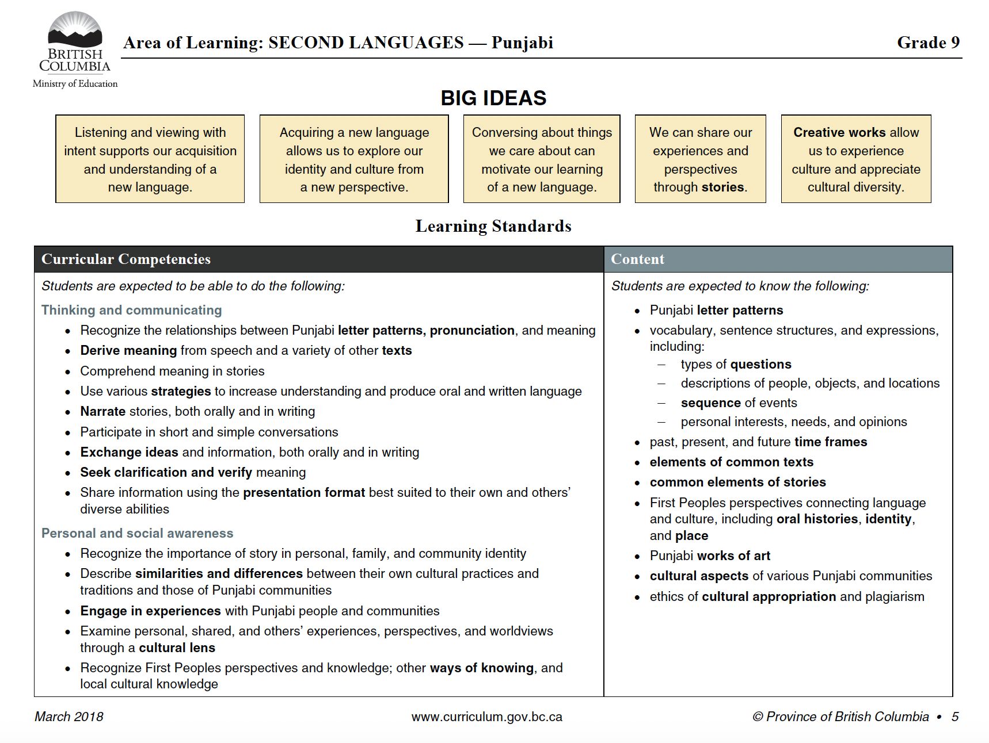
Big Ideas (Understand):
Concepts
Theories
Principles
Generalizations
Patterns
Transcending time
Transferable to new and different contexts
“Ah ha” moments
Curricular Competencies (Do):
Skills
Strategies
Processes
Applications
Dispositions
Content (Know):
Vocabulary
Facts
Topics
Concepts
Disciplinary Knowledge
Processes
Notes:
Our curriculum is designed in the KDU (know do and understand) model. Big ideas are enduring understands that students develop over time and they include concepts, theories, principles, patterns, ah-ha moments – we don’t formally assess these. They transcend time and are transferrable to new and different contexts.
Our learning standards are comprised of the curricular competency and content for that area of learning. The curricular competencies are the ‘do’ part of the model and include skills, strategies, processes, applications and development of dispositions. The content is the ‘know’ part of the model. It includes vocabulary, facts, topics, concepts, the disciplinary knowledge of that area of learning as well as some processes.
The curricular competencies include bullets of sub-skills intended to be developed over time. Teachers make decisions about which standards they will prioritize based on their learners and context as not all will be formally assessed and reported on.

Slide 8
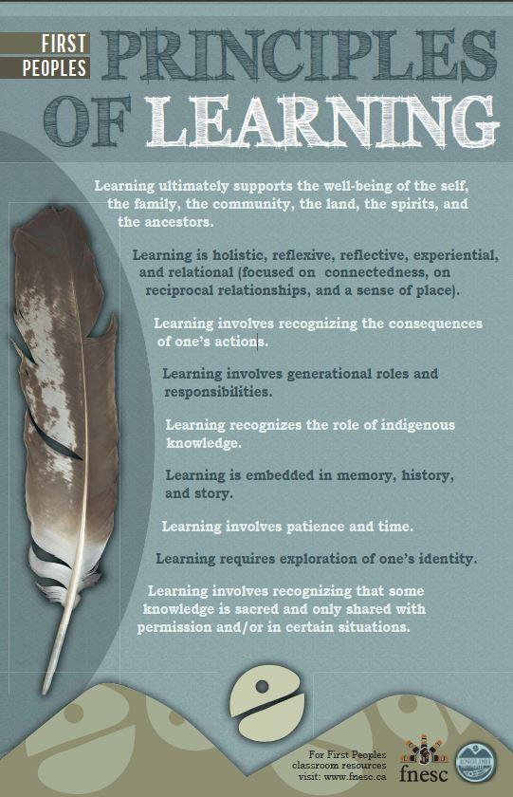
Learner-Centered
British Columbia’s schools include young people of varied backgrounds, interests, and abilities.
When selecting specific topics, activities, and resources to support the implementation of the curriculum, teachers are encouraged to ensure that these choices support inclusion, equity, and accessibility for all students.
In particular, teachers should ensure that classroom instruction, assessment, and resources reflect sensitivity to diversity and incorporate positive role portrayals, relevant issues, and themes such as inclusion, respect, and acceptance. This includes diversity in perspectives, cultural backgrounds, family composition, gender identity, and sexual orientation to name just a few.
Notes:
The shift in our redesigned curriculum is a reflection of the fast paced, technology rich, globalized, interconnected world that we live in. So, before we begin to explore the implications of this curriculum and assessment, we think it’s important to reconnect with the “why” behind the shift
The first peoples’ principals of learning provided a crucial lens for teacher teams in drafting the curriculum and all curriculum teams included indigenous representation. Just to pull from a few of the principles – learning ultimately supports the wellbeing of the self and the community. It is reflective, experiential and relational. It Involves recognizing the consequences of ones actions, requires exploration of ones identity and requires patience and time.
Personalized learning acknowledges that not all students learn successfully at the same rate, in the same learning environment, and in the same ways. It involves the provision of high-quality and engaging learning opportunities that meet the diverse needs of all students.
Personalized learning focuses on enhancing student engagement in learning and giving students choices — more of a say in what and how they learn — leading to lifelong, self-directed learning. Students and teachers develop learning plans to build on student’s interests, goals, and learning needs. Involving students in reflecting on their work and setting new goals based on their reflections allows them to take more control of their learning.
Based off the perspectives, approaches, and design of our curriculum, assessment needs to be fair, transparent and equitable to be truly learner centered.

Slide 9
Growth Over Time
Growth over time...measures a student’s progress between two or more points of time to demonstrate their progression toward goals, even if the student has not yet achieved proficiency.
It is important to identify and share the growth that is happening because even though the student may not have achieved proficiency, it is important to honour the growth and progress that is happening.
When students feel they are being successful, it increases motivation and efficacy.
Notes:
One of underpinnings of our concept based, competency driven redesigned curriculum is capturing growth over time of the learning standards. We want to take a moment here to define this concept so that we have a shared understanding.
Growth over time...measures a student’s progress between two or more points of time to demonstrate their progression toward goals, even if the student has not yet achieved proficiency.
It is important to identify and share the growth that is happening because even though the student may not have achieved proficiency, it is important to honour the growth and progress that is happening.
When students feel they are being successful, it increases motivation and efficacy.

Slide 10
PAUSE
Q1: What assessment strategies and processes can I/do I use to capture evidence of learning and communicate growth over time?
Q2: Pick an area of learning, what big ideas and key concepts will you develop at a specific grade level.
Notes:
This is the end of part 3. Please Pause the video at this time and engage in table talk discussions with the following question.

